Slide 1
Data Science Chapter 1: Introduction to Big Data
Agenda
What is Big Data?
What is Data Science?
What is the relationship between Big Data and Data Science?

Slide 2
Data All Around
Lots of data is being collected and warehoused
Web data, e-commerce
Financial transactions, bank/credit transactions
Online trading and purchasing
Social Network

Slide 3
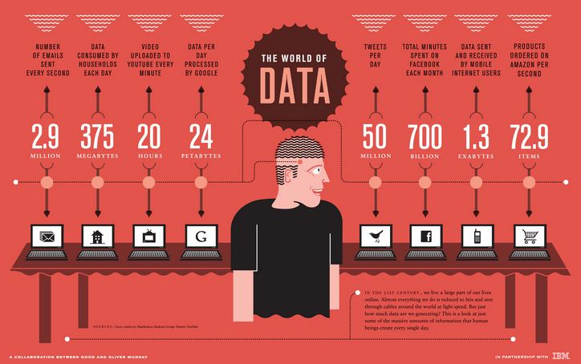
How Much Data Do We have?
Google processes 20 PB a day (2008)
Facebook has 60 TB of daily logs
eBay has 6.5 PB of user data + 50 TB/day (5/2009)
1000 genomes project: 200 TB
Cost of 1 TB of disk: $35
Time to read 1 TB disk: 3 hrs
(100 MB/s)

Slide 4
Big Data Definition
Big Data is any data that is expensive to manage and hard to extract value from
Volume
The size of the data
Velocity
The latency of data processing relative to the growing demand for interactivity
Variety and Complexity
the diversity of sources, formats, quality, structures.

Slide 5
Big Data Overview
Industries that gather and exploit data
Credit card companies monitor purchases
Good at identifying fraudulent purchases
Mobile phone companies analyze calling patterns – e.g., even on rival networks
Look for customers might switch providers
For social networks data is primary product
Intrinsic value increases as data grows

Slide 6
Attributes Defining Big Data Characteristics
Huge volume of data
Not just thousands/millions, but billions of items
Complexity of data types and structures
Vareity of sources, formats, structures
Speed of new data creation and grow
High velocity, rapid ingestion, fast analysis

Slide 7
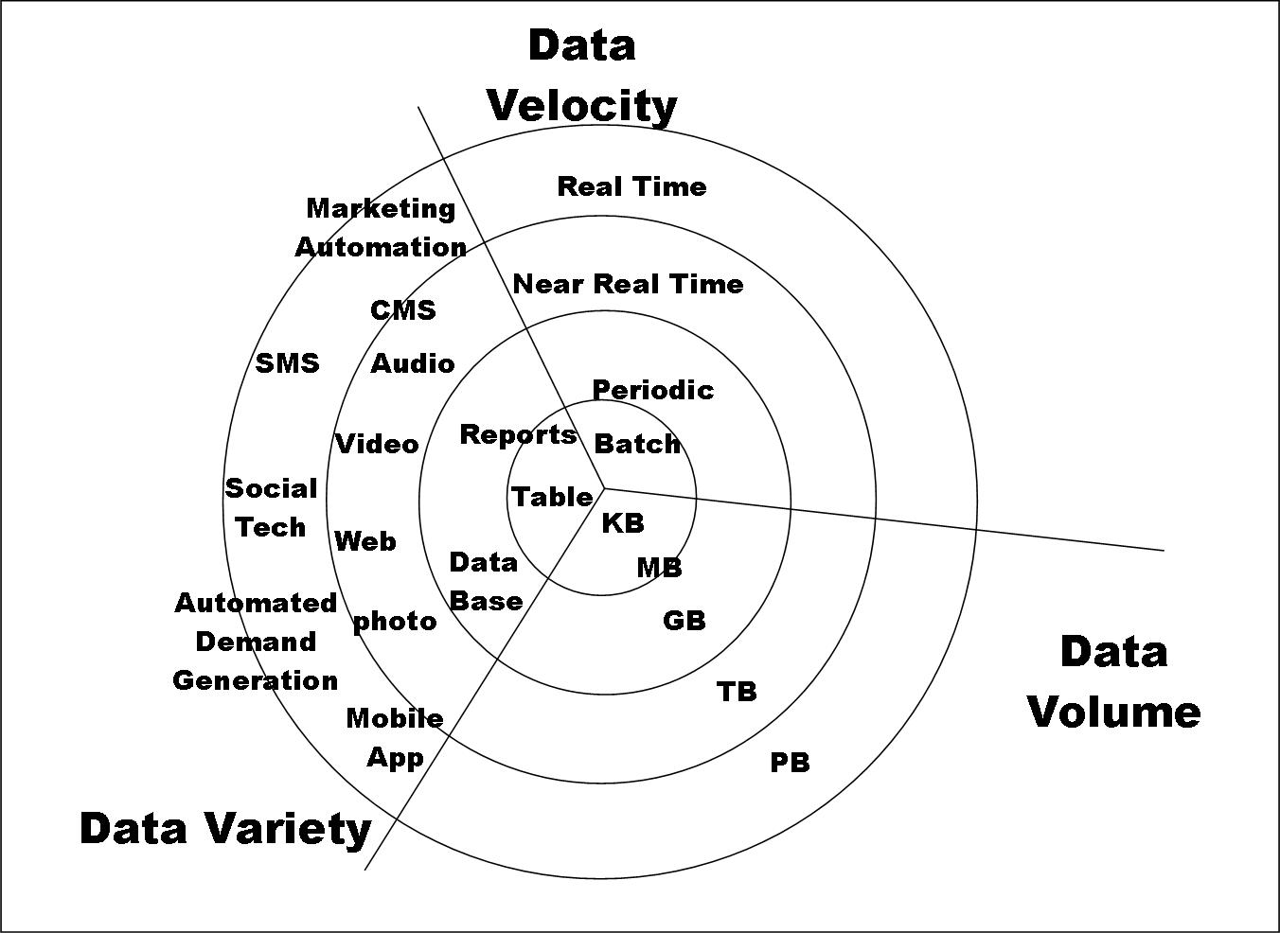
Big Data

Slide 8
Types of Data We Have
Relational Data (Tables/Transaction/Legacy Data)
Text Data (Web)
Semi-structured Data (XML)
Graph Data
Social Network, Semantic Web (RDF), …
Streaming Data
You can afford to scan the data once

Slide 9
What To Do With These Data?
Aggregation and Statistics
Data warehousing and OLAP
Indexing, Searching, and Querying
Keyword based search
Pattern matching (XML/RDF)
Knowledge discovery
Data Mining
Statistical Modeling

Slide 10
Sources of Big Data Deluge
Mobile sensors – GPS, accelerometer, etc.
Social media – 700 Facebook updates/sec in2012
Video surveillance – street cameras, stores, etc.
Video rendering – processing video for display
Smart grids – gather and act on information
Geophysical exploration – oil, gas, etc.
Medical imaging – reveals internal body structures
Gene sequencing – more prevalent, less expensive, healthcare would like to predict personal illnesses

Slide 11
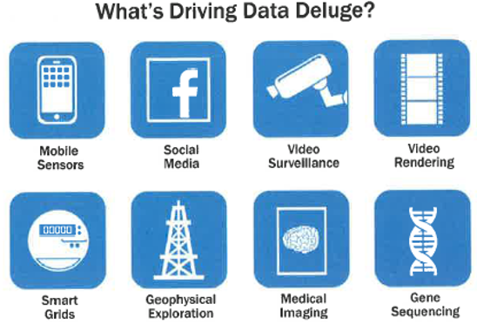

Slide 12
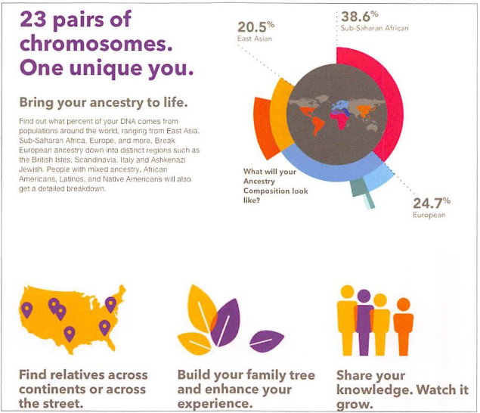
Example: Genotyping from 23andme.com

Slide 13
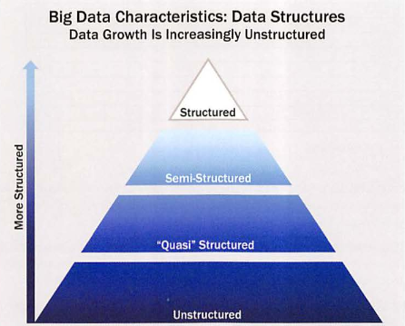
Characteristics of Big Data

Slide 14
Structured – defined data type, format, structure
Transactional data, OLAP cubes, RDBMS, CSV files, spreadsheets
Semi-structured
Text data with discernable patterns – e.g., XML data
Quasi-structured
Text data with erratic data formats – e.g., clickstream data
Unstructured
Data with no inherent structure – text docs, PDF’s, images, videos

Slide 15
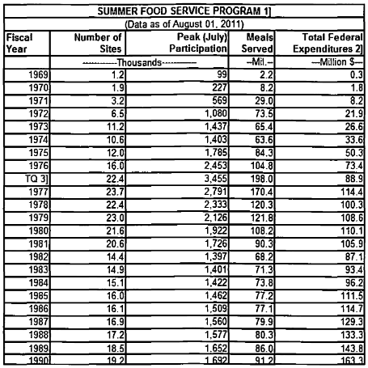
Example of Structured Data

Slide 16
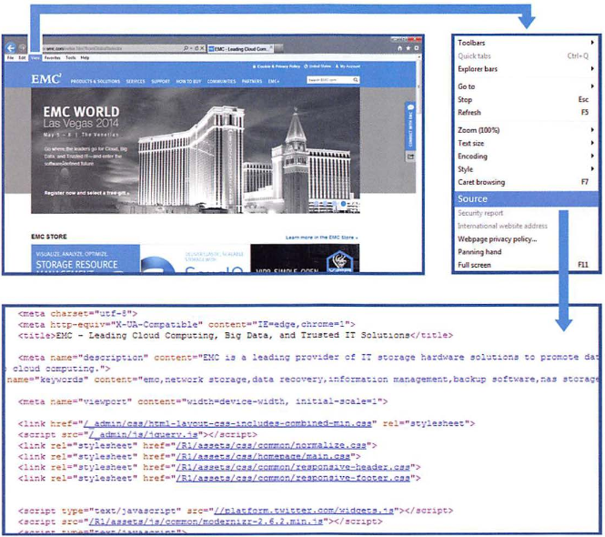
Example of Semi-Structured Data

Slide 17
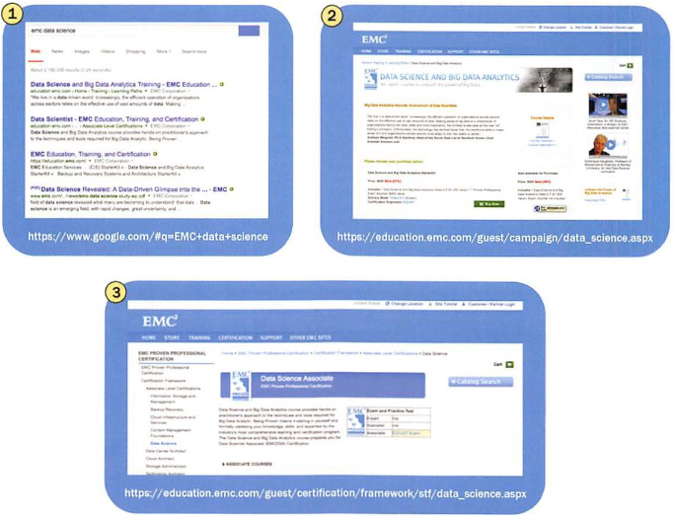
Example of Quasi-Structured Data visiting 3 websites adds 3 URLs to user’s log files

Slide 18
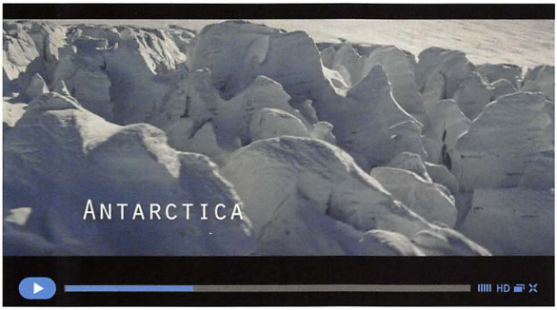
Example of Unstructured Data Video about Antarctica Expedition

Slide 19
Datafication
Datafication is a process of “taking all aspects of life and turning them into data”
Examples:
1. Google’s augmented-reality glasses datafy the gaze.
2. Twitter datafies stray thoughts.
3. LinkedIn datafies professional networks
Once we datafy things, we can transform their purpose and turn the information into new forms of value.

Slide 20
Introduction to Data Science
Applying advanced statistical tools to existing data to generate new insights is known as “Data Science”.
Data Science is the science which uses computer science, statistics and machine learning, visualization and human-computer interactions to collect, clean, integrate, analyze, visualize, interact with data to create data products.

Slide 21
An area that manages, manipulates, extracts, and interprets knowledge from tremendous amount of data
Data science (DS) is a multidisciplinary field of study with goal to address the challenges in big data
Data science principles apply to all data – big and small
Turn data into data products

Slide 22

Goal of Data Science
Turn data into data products.
Visual Definition

Slide 23
Theories and techniques from many fields and disciplines are used to investigate and analyze a large amount of data to help decision makers in many industries such as science, engineering, economics, politics, finance, and education
Computer Science
Pattern recognition, visualization, data warehousing, High performance computing, Databases, AI
Mathematics
Mathematical Modeling
Statistics
Statistical and Stochastic modeling, Probability.

Slide 24
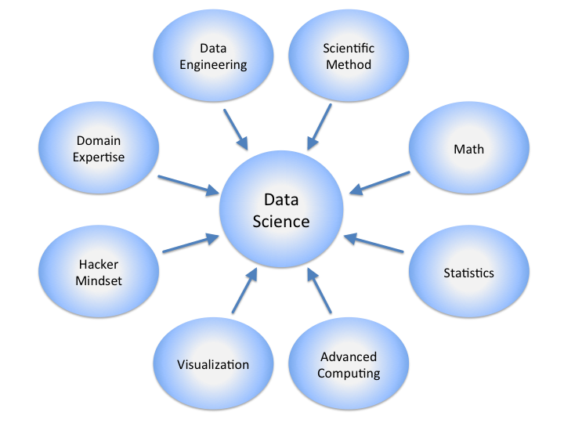

Slide 25
Real Life Examples
Companies learn your secrets, shopping patterns, and preferences
For example, can we know if a woman is pregnant, even if she doesn’t want us to know? Target case study
Data Science and election (2008, 2012)
1 million people installed the Obama Facebook app that gave access to info on “friends”

Slide 26
Data Scientists
They find stories, extract knowledge. They are not reporters
Data scientists are the key to realizing the opportunities presented by big data. They bring structure to it, find compelling patterns in it, and advise executives on the implications for products, processes, and decisions

Slide 27
What do they do?
National Security
Cyber Security
Business Analytics
Engineering
Healthcare
And more ….

Slide 28
Three Recurring Data Scientist Activities
Reframe business challenges as analytics challenges
Design, implement, and deploy statistical models and data mining techniques on Big Data
Develop insights that lead to actionable recommendations

Slide 29
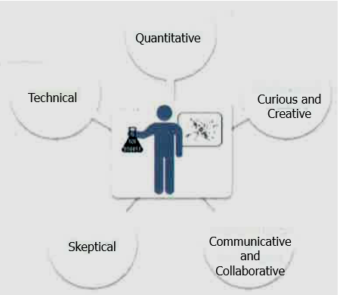
Profile of Data Scientist Five Main Sets of Skills

Slide 30
Profile of Data Scientist Five Main Sets of Skills
Quantitative skill – e.g., math, statistics
Technical aptitude – e.g., software engineering, programming
Skeptical mindset and critical thinking – ability to examine work critically
Curious and creative – passionate about data and finding creative solutions
Communicative and collaborative – can articulate ideas, can work with others

Slide 31
Data Analytics Lifecycle
Data science projects differ from BI projects
More exploratory in nature
Critical to have a project process
Participants should be thorough and rigorous
Break large projects into smaller pieces
Spend time to plan and scope the work
Documenting adds rigor and credibility

Slide 32
Data Analytics Lifecycle
Data Analytics Lifecycle Overview
Phase 1: Discovery
Phase 2: Data Preparation
Phase 3: Model Planning
Phase 4: Model Building
Phase 5: Communicate Results
Phase 6: Operationalize

Slide 33
Data Analytics Lifecycle Overview
The data analytic lifecycle is designed for Big Data problems and data science projects
With six phases the project work can occur in several phases simultaneously
The cycle is iterative to portray a real project
Work can return to earlier phases as new information is uncovered

Slide 34
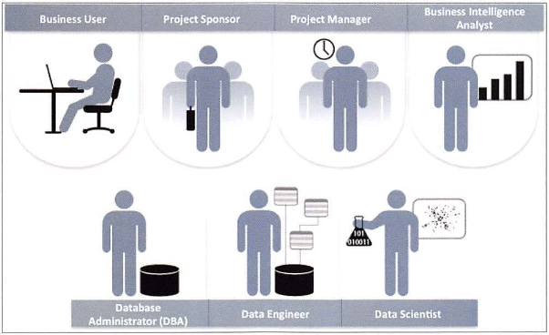
Key Roles for a Successful Analytics Project

Slide 35
Key Roles for a Successful Analytics Project
Business User – understands the domain area
Project Sponsor – provides requirements
Project Manager – ensures meeting objectives
Business Intelligence Analyst – provides business domain expertise based on deep understanding of the data
Database Administrator (DBA) – creates DB environment
Data Engineer – provides technical skills, assists data management and extraction, supports analytic sandbox
Data Scientist – provides analytic techniques and modeling

Slide 36
Background and Overview of Data Analytics Lifecycle
Data Analytics Lifecycle defines the analytics process and best practices from discovery to project completion
The Lifecycle employs aspects of
Scientific method
Cross Industry Standard Process for Data Mining (CRISP-DM)
Process model for data mining
Davenport’s DELTA framework
Hubbard’s Applied Information Economics (AIE) approach
MAD Skills: New Analysis Practices for Big Data by Cohen et al.

Slide 37
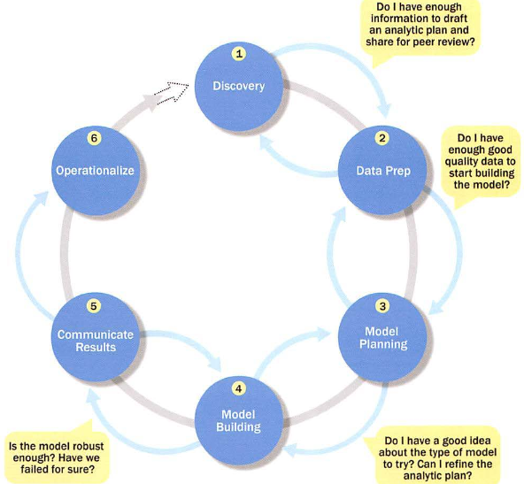
Overview of Data Analytics Lifecycle

Slide 38
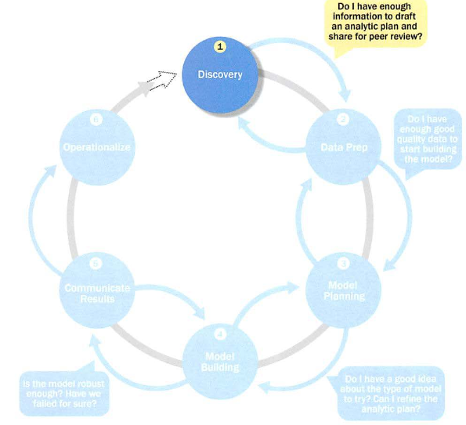
Phase 1: Discovery

Slide 39
Phase 1: Discovery
Learning the Business Domain
Resources
Framing the Problem
Identifying Key Stakeholders
Interviewing the Analytics Sponsor
Developing Initial Hypotheses
Identifying Potential Data Sources

Slide 40
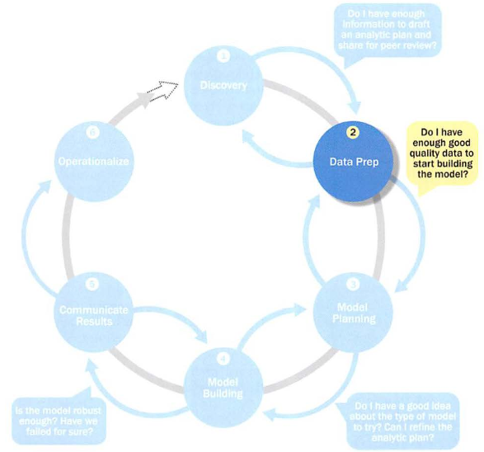
Phase 2: Data Preparation

Slide 41
Phase 2: Data Preparation
Includes steps to explore, preprocess, and condition data
Create robust environment – analytics sandbox
Data preparation tends to be the most labor-intensive step in the analytics lifecycle
Often at least 50% of the data science project’s time
The data preparation phase is generally the most iterative and the one that teams tend to underestimate most often

Slide 42
Preparing the Analytic Sandbox
Create the analytic sandbox (also called workspace)
Allows team to explore data without interfering with live production data
Sandbox collects all kinds of data (expansive approach)
The sandbox allows organizations to undertake ambitious projects beyond traditional data analysis and BI to perform advanced predictive analytics
Although the concept of an analytics sandbox is relatively new, this concept has become acceptable to data science teams and IT groups

Slide 43
Performing ETLT (Extract, Transform, Load, Transform)
In ETL users perform extract, transform, load
In the sandbox the process is often ELT – early load preserves the raw data which can be useful to examine
Example – in credit card fraud detection, outliers can represent high-risk transactions that might be inadvertently filtered out or transformed before being loaded into the database
Hadoop is often used here

Slide 44
Learning about the Data
Becoming familiar with the data is critical
This activity accomplishes several goals:
Determines the data available to the team early in the project
Highlights gaps – identifies data not currently available
Identifies data outside the organization that might be useful

Slide 45
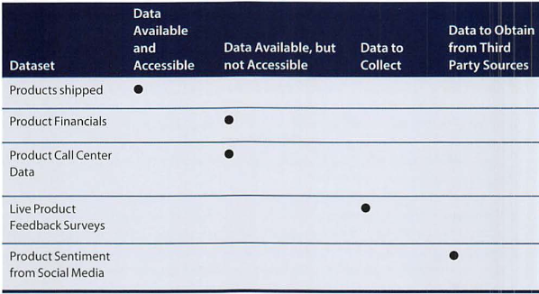
Learning about the Data Sample Dataset Inventory

Slide 46
Data Conditioning
Data conditioning includes cleaning data, normalizing datasets, and performing transformations
Often viewed as a preprocessing step prior to data analysis, it might be performed by data owner, IT department, DBA, etc.
Best to have data scientists involved
Data science teams prefer more data than too little

Slide 47
Data Conditioning
Additional questions and considerations
What are the data sources? Target fields?
How clean is the data?
How consistent are the contents and files? Missing or inconsistent values?
Assess the consistence of the data types – numeric, alphanumeric?
Review the contents to ensure the data makes sense
Look for evidence of systematic error

Slide 48
Survey and Visualize
Leverage data visualization tools to gain an overview of the data
Shneiderman’s mantra:
“Overview first, zoom and filter, then details-on-demand”
This enables the user to find areas of interest, zoom and filter to find more detailed information about a particular area, then find the detailed data in that area

Slide 49
Survey and Visualize Guidelines and Considerations
Review data to ensure calculations are consistent
Does the data distribution stay consistent?
Assess the granularity of the data, the range of values, and the level of aggregation of the data
Does the data represent the population of interest?
Check time-related variables – daily, weekly, monthly? Is this good enough?
Is the data standardized/normalized? Scales consistent?
For geospatial datasets, are state/country abbreviations consistent

Slide 50
Common Tools for Data Preparation
Hadoop can perform parallel ingest and analysis
Alpine Miner provides a graphical user interface for creating analytic workflows
OpenRefine (formerly Google Refine) is a free, open source tool for working with messy data
Similar to OpenRefine, Data Wrangler is an interactive tool for data cleansing and transformation

Slide 51
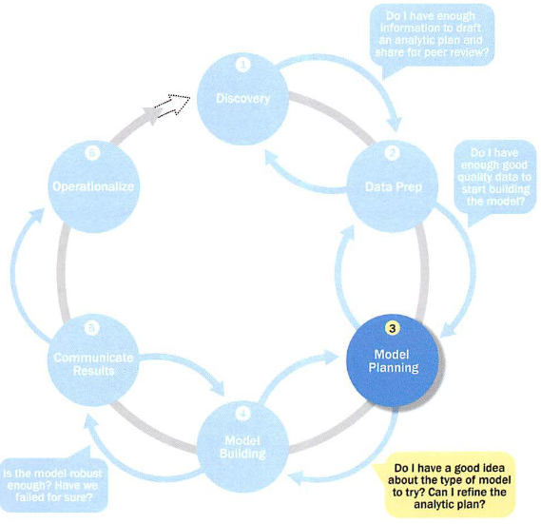
Phase 3: Model Planning

Slide 52
Phase 3: Model Planning
Activities to consider
Assess the structure of the data – this dictates the tools and analytic techniques for the next phase
Ensure the analytic techniques enable the team to meet the business objectives and accept or reject the working hypotheses
Determine if the situation warrants a single model or a series of techniques as part of a larger analytic workflow
Research and understand how other analysts have approached this kind or similar kind of problem

Slide 53
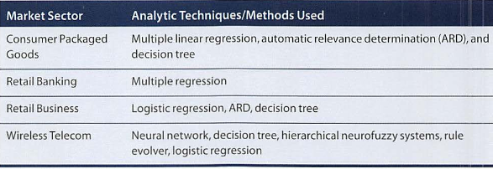
Phase 3: Model Planning Model Planning in Industry Verticals
Example of other analysts approaching a similar problem

Slide 54
Data Exploration and Variable Selection
Explore the data to understand the relationships among the variables to inform selection of the variables and methods
A common way to do this is to use data visualization tools
Often, stakeholders and subject matter experts may have ideas
For example, some hypothesis that led to the project
Aim for capturing the most essential predictors and variables
This often requires iterations and testing to identify key variables
If the team plans to run regression analysis, identify the candidate predictors and outcome variables of the model

Slide 55
Model Selection
The main goal is to choose an analytical technique, or several candidates, based on the end goal of the project
We observe events in the real world and attempt to construct models that emulate this behavior with a set of rules and conditions
A model is simply an abstraction from reality
Determine whether to use techniques best suited for structured data, unstructured data, or a hybrid approach
Teams often create initial models using statistical software packages such as R, SAS, or Matlab
Which may have limitations when applied to very large datasets
The team moves to the model building phase once it has a good idea about the type of model to try

Slide 56
Common Tools for the Model Planning Phase
R has a complete set of modeling capabilities
R contains about 5000 packages for data analysis and graphical presentation
SQL Analysis services can perform in-database analytics of common data mining functions, involved aggregations, and basic predictive models
SAS/ACCESS provides integration between SAS and the analytics sandbox via multiple data connections

Slide 57
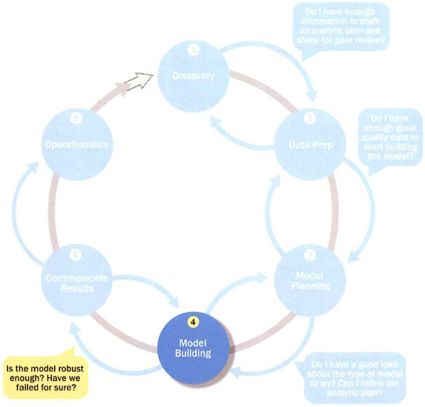
Phase 4: Model Building

Slide 58
Phase 4: Model Building
Execute the models defined in Phase 3
Develop datasets for training, testing, and production
Develop analytic model on training data, test on test data
Question to consider
Does the model appear valid and accurate on the test data?
Does the model output/behavior make sense to the domain experts?
Do the parameter values make sense in the context of the domain?
Is the model sufficiently accurate to meet the goal?
Does the model avoid intolerable mistakes?
Are more data or inputs needed?
Will the kind of model chosen support the runtime environment?
Is a different form of the model required to address the business problem?

Slide 59
Common Tools for the Model Building Phase
Commercial Tools
SAS Enterprise Miner – built for enterprise-level computing and analytics
SPSS Modeler (IBM) – provides enterprise-level computing and analytics
Matlab – high-level language for data analytics, algorithms, data exploration
Alpine Miner – provides GUI frontend for backend analytics tools
STATISTICA and MATHEMATICA – popular data mining and analytics tools
Free or Open Source Tools
R and PL/R - PL/R is a procedural language for PostgreSQL with R
Octave – language for computational modeling
WEKA – data mining software package with analytic workbench
Python – language providing toolkits for machine learning and analysis
SQL – in-database implementations provide an alternative tool

Slide 60
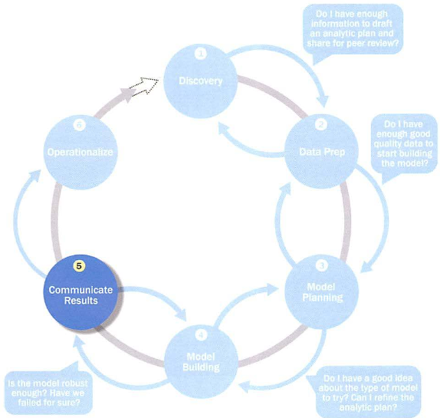
Phase 5: Communicate Results

Slide 61
Phase 5: Communicate Results
Determine if the team succeeded or failed in its objectives
Assess if the results are statistically significant and valid
If so, identify aspects of the results that present salient findings
Identify surprising results and those in line with the hypotheses
Communicate and document the key findings and major insights derived from the analysis
This is the most visible portion of the process to the outside stakeholders and sponsors

Slide 62
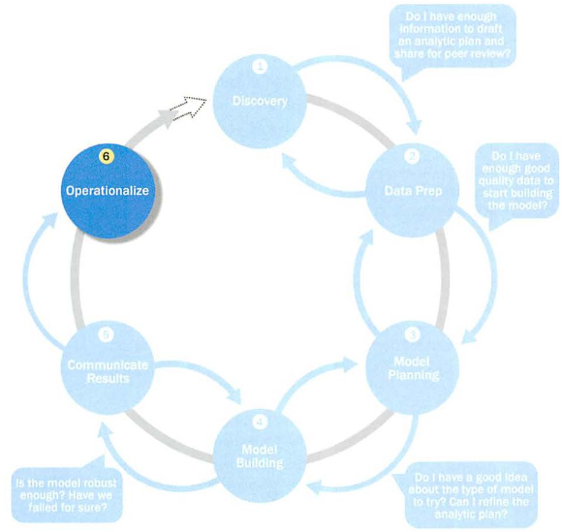
Phase 6: Operationalize

Slide 63
Phase 6: Operationalize
In this last phase, the team communicates the benefits of the project more broadly and sets up a pilot project to deploy the work in a controlled way
Risk is managed effectively by undertaking small scope, pilot deployment before a wide-scale rollout
During the pilot project, the team may need to execute the algorithm more efficiently in the database rather than with in-memory tools like R, especially with larger datasets
To test the model in a live setting, consider running the model in a production environment for a discrete set of products or a single line of business
Monitor model accuracy and retrain the model if necessary

Slide 64
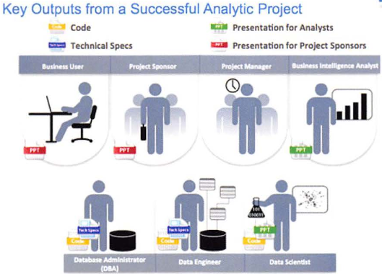
Phase 6: Operationalize Key outputs from successful analytics project

Slide 65
Phase 6: Operationalize Key outputs from successful analytics project
Business user – tries to determine business benefits and implications
Project sponsor – wants business impact, risks, ROI
Project manager – needs to determine if project completed on time, within budget, goals met
Business intelligence analyst – needs to know if reports and dashboards will be impacted and need to change
Data engineer and DBA – must share code and document
Data scientist – must share code and explain model to peers, managers, stakeholders

Slide 66
Phase 6: Operationalize Four main deliverables
Although the seven roles represent many interests, the interests overlap and can be met with four main deliverables
Presentation for project sponsors – high-level takeaways for executive level stakeholders
Presentation for analysts – describes business process changes and reporting changes, includes details and technical graphs
Code for technical people
Technical specifications of implementing the code

Slide 67
Case Study: Global Innovation Network and Analysis (GINA)
In 2012 EMC’s new director wanted to improve the company’s engagement of employees across the global centers of excellence (GCE) to drive innovation, research, and university partnerships
This project was created to accomplish
Store formal and informal data
Track research from global technologists
Mine the data for patterns and insights to improve the team’s operations and strategy

Slide 68
Phase 1: Discovery
Team members and roles
Business user, project sponsor, project manager – Vice President from Office of CTO
BI analyst – person from IT
Data engineer and DBA – people from IT
Data scientist – distinguished engineer

Slide 69
Phase 1: Discovery
The data fell into two categories
Five years of idea submissions from internal innovation contests
Minutes and notes representing innovation and research activity from around the world
Hypotheses grouped into two categories
Descriptive analytics of what is happening to spark further creativity, collaboration, and asset generation
Predictive analytics to advise executive management of where it should be investing in the future

Slide 70
Phase 2: Data Preparation
Set up an analytics sandbox
Discovered that certain data needed conditioning and normalization and that missing datasets were critical
Team recognized that poor quality data could impact subsequent steps
They discovered many names were misspelled and problems with extra spaces
These seemingly small problems had to be addressed

Slide 71
Phase 3: Model Planning
The study included the following considerations
Identify the right milestones to achieve the goals
Trace how people move ideas from each milestone toward the goal
Tract ideas that die and others that reach the goal
Compare times and outcomes using a few different methods

Slide 72
Phase 4: Model Building
Several analytic method were employed
NLP on textual descriptions
Social network analysis using R and Rstudio
Developed social graphs and visualizations

Slide 73
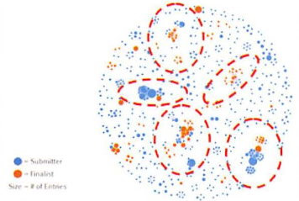
Phase 4: Model Building Social graph of data submitters and finalists

Slide 74
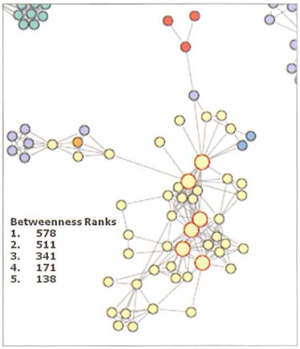
Phase 4: Model Building Social graph of top innovation influencers

Slide 75
Phase 5: Communicate Results
Study was successful in in identifying hidden innovators
Found high density of innovators in Cork, Ireland
The CTO office launched longitudinal studies

Slide 76
Phase 6: Operationalize
Deployment was not really discussed
Key findings
Need more data in future
Some data were sensitive
A parallel initiative needs to be created to improve basic BI activities
A mechanism is needed to continually reevaluate the model after deployment

Slide 77
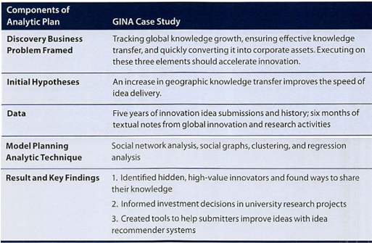
Phase 6: Operationalize

